Slide 1
Personal Finance Manager
Sonia. M
3rd Semester MCA
Brindavan College

Slide 2
Abstract
Managing personal finances effectively is crucial for financial stability. This project aims to develop a Personal Finance Manager that helps users track income, expenses, and budgets. By categorizing transactions, setting financial goals, and visualizing spending patterns, users can gain better control over their money. The application utilizes Python, Pandas, Matplotlib, and Seaborn for data handling and visualization.

Slide 3
Problem Statement
Many individuals struggle with tracking their expenses and staying within budget.
Lack of financial awareness leads to unnecessary spending.
People often find manual expense tracking tedious and time-consuming.
No proper insights into spending habits and savings progress.
A need for a simple personal finance management tool with visual reports.

Slide 4
Proposed Solution
Develop a Personal Finance Manager that allows users to log income and expenses.
Categorize transactions (e.g., Food, Rent, Entertainment, Savings).
Set budget goals and get alerts when exceeding them.
Generate visual reports like bar charts, pie charts, and trend graphs using Matplotlib & Seaborn.
Provide monthly and yearly financial summaries to help users make better financial decisions.

Slide 5
Implementation Code
GitHub: https://github.com/SoniaM-0402/TSP4.0/blob/main/PersonalFinanceManager.py

Slide 6
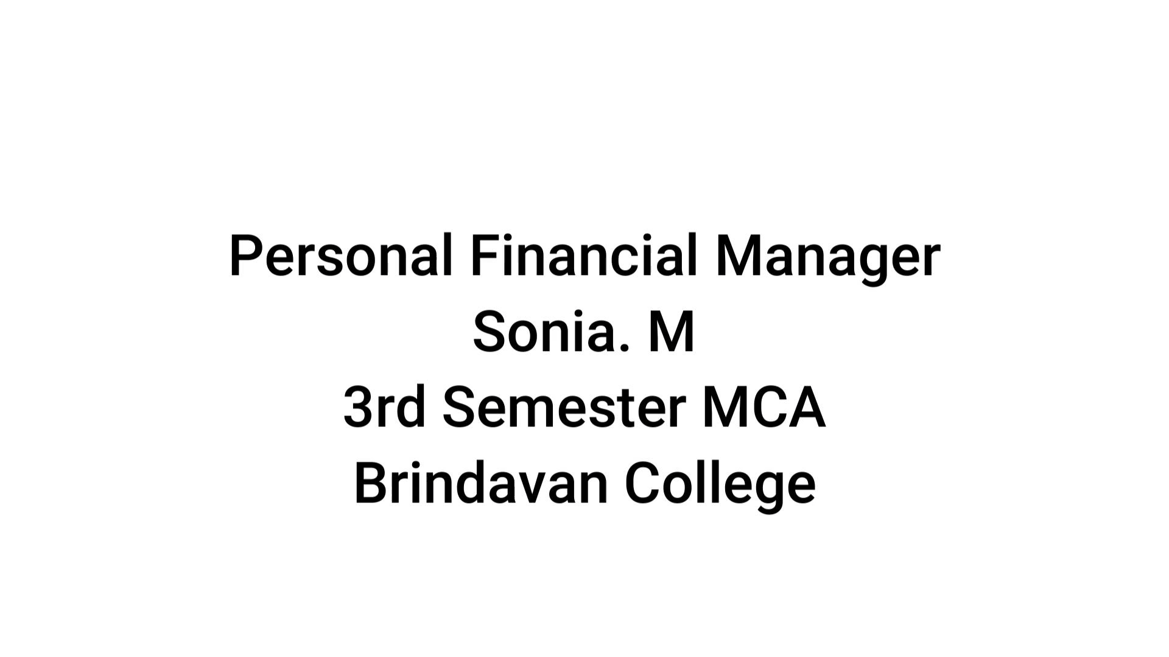
Short Video

Slide 7
Video Link
G-Drive: https://drive.google.com/file/d/1X576x1544R8fo8ejg1UYnFWgJqw2bKXo/view?usp=sharing

Slide 8
OUTPUTS

Slide 9
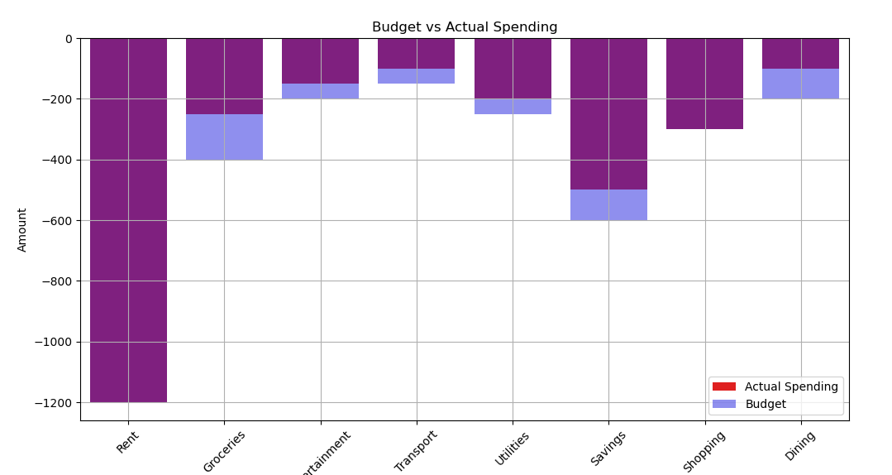
Budget vs Actual Spending

Slide 10
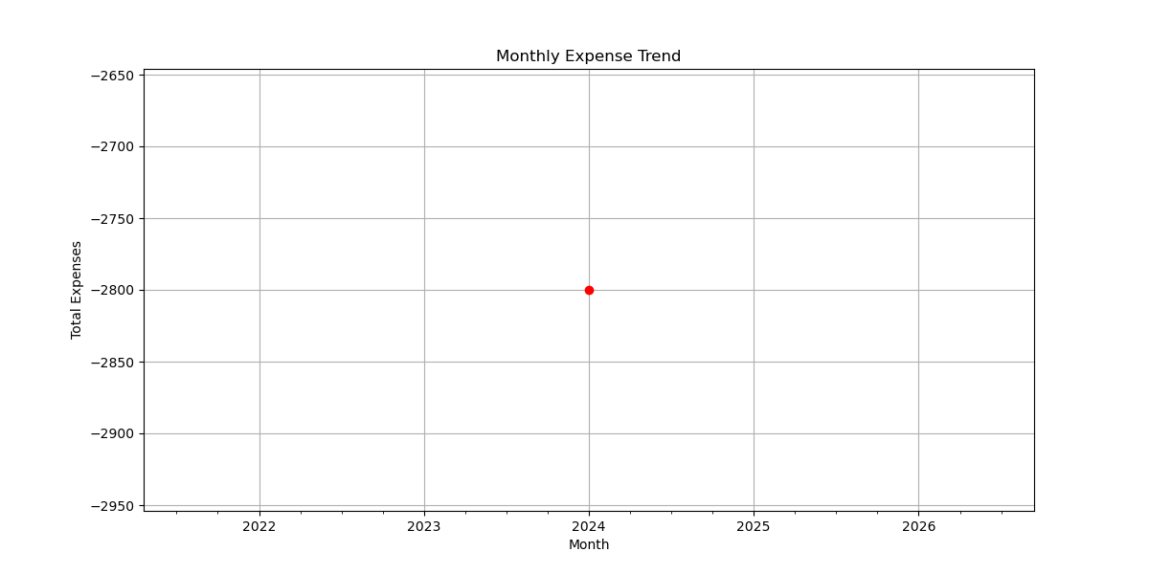
Monthly Expense Trend

Slide 11
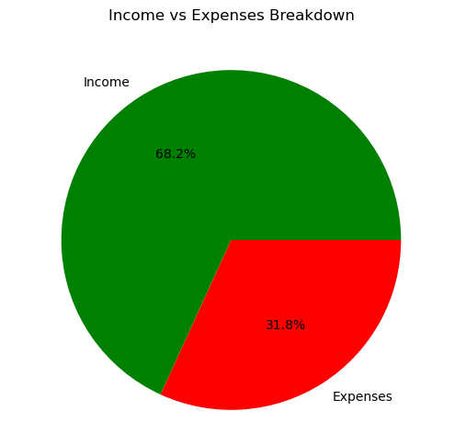
Income vs Expense

Slide 12
Thank You

